Slide 1
Analyzing Texts

Slide 2
Why Textual Analysis?
To understand cultural phenomenon
To evaluate the credibility of research
To understand how arguments function
It means we are critical readers.
Being a critical reader helps us go beyond what is being said to consider HOW it is being said.
Knowing how something is said means we are aware of how messages in the world affect us and others.
Notes:
Textual analysis is commonly used in academic circles, for a variety of reasons: to understand cultural phenomenon, to evaluate the credibility of research, to understand how arguments function, etc.
Being able to analyze texts means that we are critical readers. We can go beyond what is being said to consider HOW it is being said. From there we can be aware of how messages in the world affect us.

Slide 3

Close Examination of a Text
View the video about Analysis here: https://www.youtube.com/watch?v=R_bgo8j6jxc&t=366s
  Pay attention to the steps and processes they discuss in the video.
  What are your key takeaways?

Slide 4
What Does the Book Say?
Turn to the readings you needed to complete for today.
What are some things the book suggests you look for when you analyze a text?
What are your key takeaways?

Slide 5
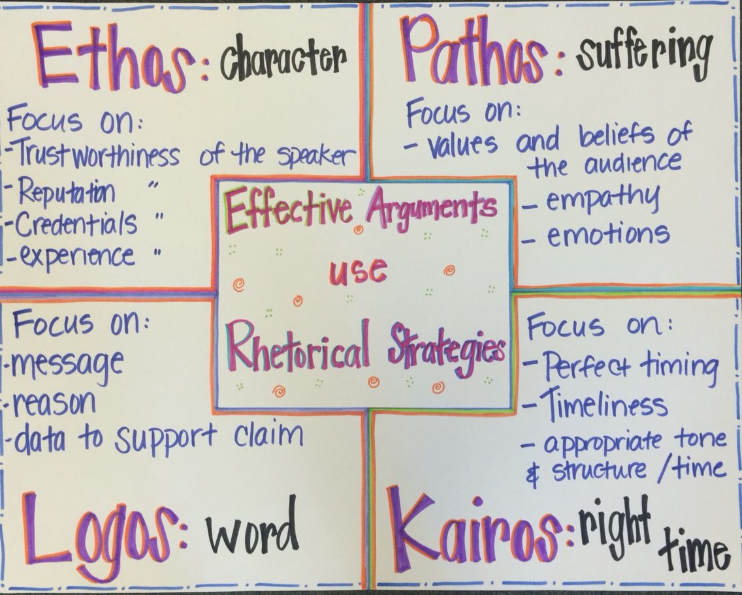
The 4 Appeals

Slide 6
What are some examples of each appeal?
Logos
Ethos
Pathos
Kairos

Slide 7
Analyzing Ads
Today we are going to look at several advertisements to consider what the author is doing.
Overview:
  First, we will look at two print advertisements as a group.
  Then, you will be broken into smaller groups to discuss four advertisements. You will share your findings with the class.
  Finally, we will look at some film advertisements, you will jot down some thoughts, and then we will discuss those as a group.

Slide 8
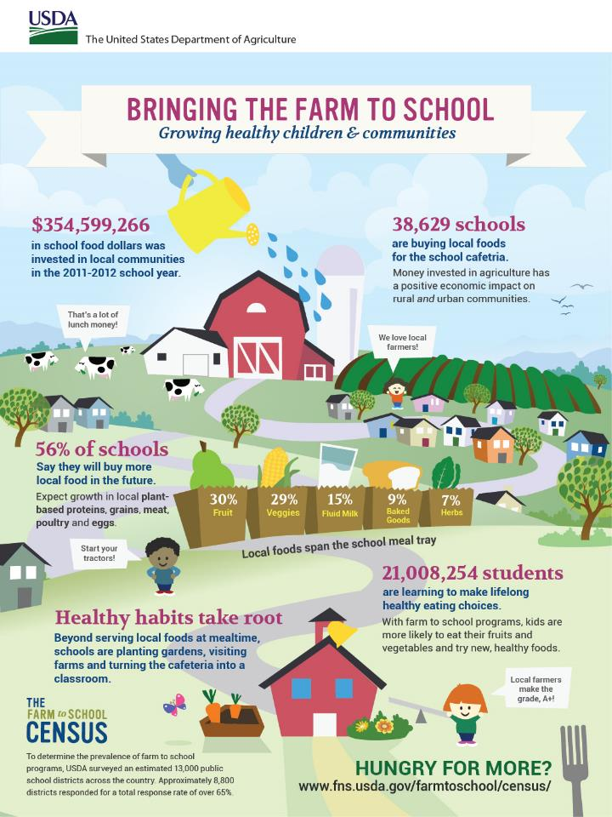
What is the rhetorical situation (audience, purpose, stance, genre, design)?
Images: What are the visual and design elements?
Text: What is the tone? Where does the information come from?
What is not there?
Notes:
USDA Farm to School Census Infographic. “Bringing the Farm to School.” Flickr. 11 Oct 2022.

Slide 9
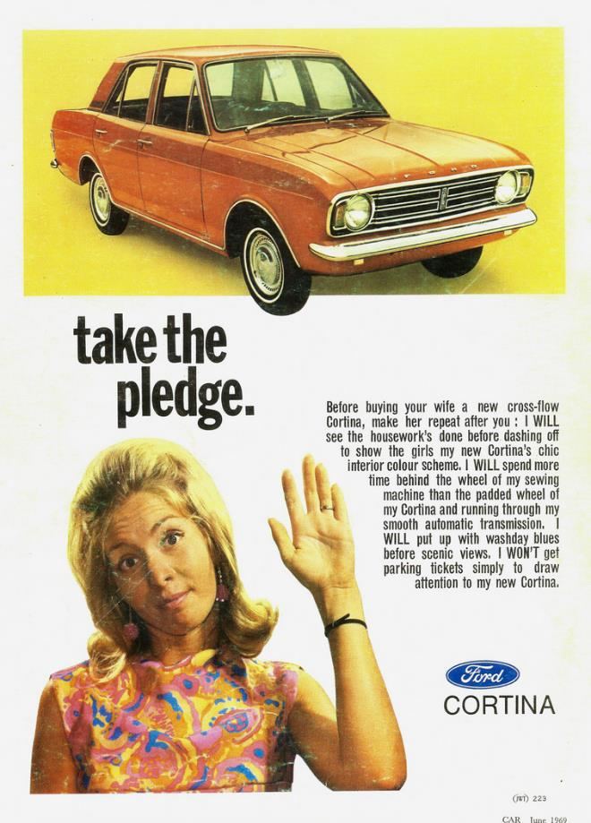
What is the rhetorical situation (audience, purpose, stance, genre, design)?
Images: What are the visual and design elements?
Text: What is the tone? Where does the information come from?
What is not there?
Notes:
“1969 Ford Cortina.” Flickr. 11 Oct 2022

Slide 10
Discussion: Analyzing Ads
Turn to the person next to you. Consider the questions below in relation to the visual your group has been assigned to.
  What is the rhetorical situation (audience, purpose, stance, genre, design)?
  Images: What are the visual and design elements?
  Text: What is the tone? Where does the information come from?
  What is not there?
Be prepared to share with the large group.

Slide 11

Group 1

Slide 12

Group 2

Slide 13

Group 3

Slide 14

Group 4

Slide 15
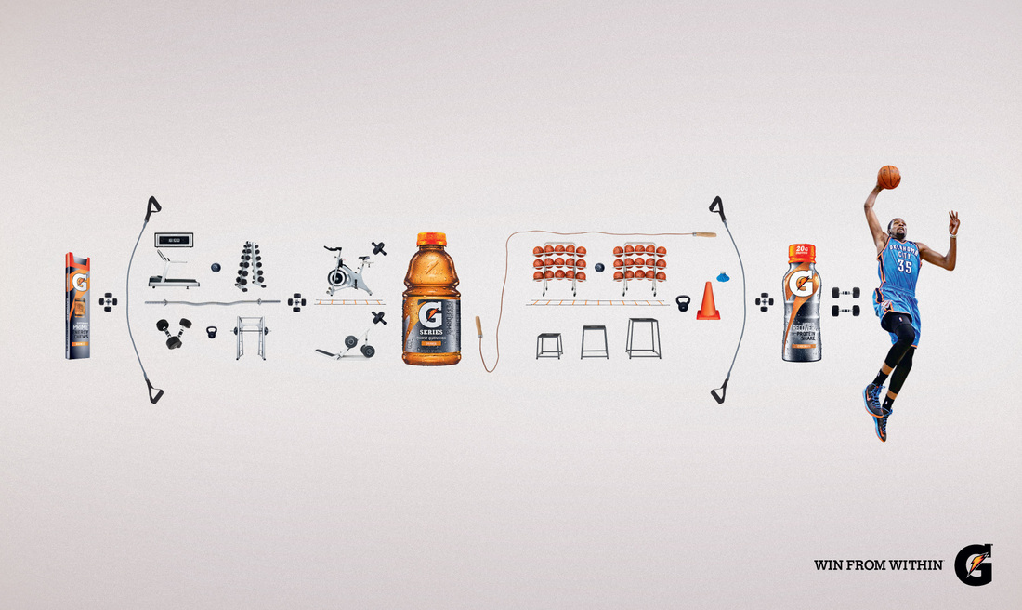
Group 5

Slide 16
Great! Now, let’s look at television ads
Consider
  What is the rhetorical situation (audience, purpose, stance, genre, design)?
  Images: What are the visual and design elements?
  Text: What is the tone? Where does the information come from?
  What is not there?
Be prepared to share with the class.

Slide 17


Slide 18
Old Spice Ad Analysis
What is the rhetorical situation (audience, purpose, stance, genre, design)?
Images: What are the visual and design elements?
Text: What is the tone? Where does the information come from?
What is not there?

Slide 19
Got Milk?
https://www.youtube.com/watch?v=OLSsswr6z9Y&t=5s

Slide 20
Got Milk? Ad Analysis
What is the rhetorical situation (audience, purpose, stance, genre, design)?
Images: What are the visual and design elements?
Text: What is the tone? Where does the information come from?
What is not there?

Slide 21
GEICO Horror Ad
https://www.youtube.com/watch?v=NYae3ZAAbLc

Slide 22
GEICO Horror Ad Analysis
What is the rhetorical situation (audience, purpose, stance, genre, design)?
Images: What are the visual and design elements?
Text: What is the tone? Where does the information come from?
What is not there?

Slide 23
Reflection
Ok, so … looking back on today … let’s reflect. Take 2-3 minutes to answer the questions below on a sheet of paper. Be prepared to share with a neighbor and/or the class:
  So what?
  What seemed like a no-brainer to you?
  What did you see or learn that was new?
  What questions do you still have?

